Slide 1
Sentiment Analysis on Movie reviews
Sushumna Chiluveru (F03632)
Kaggle Link: https://www.kaggle.com/c/sentiment-analysis-on-movie-reviews/data

Slide 2
Using NLP to solve real world text anlaytics problems
INSIGHTS ABOUT TRAINING DATA:
The input data format contains a review in text format and the sentiment.
The review is further broken down into all possible n-grams (to create phrases irrespective of their validity).
So, the training data itself contains many outliers. Strings like “a”, ”the ” ..etc. the ones containing stop words are the major outliers in the training data.
We can’t straight away remove these outliers since they show up in the testing data as well.

Slide 3
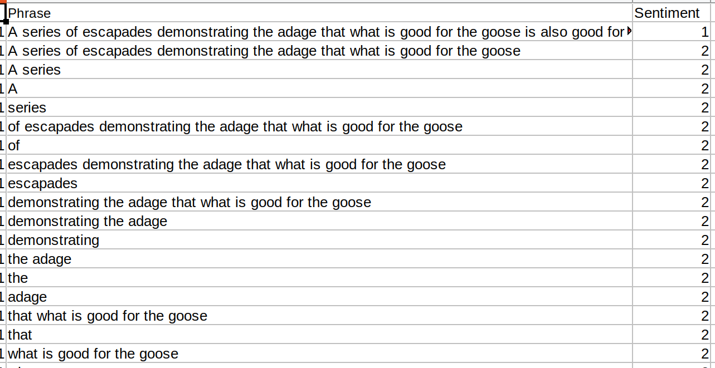
INSIGHTS ABOUT TRAINING DATA:
SAMPLE SNAPSHOT OF THE TRAINING DATA

Slide 4
MODELS IMPLEMENTED:
In such a problem statement where the training data and testing data is filled with data points which act as outliers, The performance of any model is not expected to be that good.
Initially , the common models like SVM, Naive bayes are used to map the reviews to sentiments.
Later, the state of art models like fasttext from facebook are used to check the performance.

Slide 5
MODELS USED:
The SVM, Naive bayes are used in a pipeline , where the features considered are tf-idf vectors, and the countvectorizers (Countvectorizers basically converts text data into matrix of token counts)
Later, parameter tuning is used to get the best fit parameters for the so said models.
The best fit parameters for SVM are (alpha = 1e-6, max_iter = 200, tol = None, loss =’hinge, penalty = ‘l1’’)

Slide 6
PERFORMANCE OF THE MODELS
The best fit parameters for Naive Bayes and SVM are as follows
After SVM parameter tuning , accuracy is 71.92535829940043
Using Naive bayes ,after parameter tuning the accuracy is 62.65734714162045
The fasttext statistics are as below
Read 1M words
Number of words: 18226, Number of labels: 5,Progress: 100.0% words/sec/thread: 1404530 lr: 0.000000 loss: 0.838516 ETA: 0h 0m
precision is 0.7064606741573034, recall is 0.7064606741573034

Slide 7
INSIGHTS INTO FASTTEXT:
Fasttext from facebook is efficient in learning word representations and one of the best models for sentence classification.
Fasttext training is based on CBOW(continuous bag of words and skipgram models).
THe CBOW model architecture is something that tries to predict the next sample(word) based on previous samples(words).
The surrounding words are combined to predict the missing word using the distributed representations.

Slide 8
CONCLUSION:
Of all the models, as per the accuracy metrics evaluation, The fasttext is assumed to be the best performer since It takes word embeddings and the CBOW representations to predict the labels.
The routine Naive bayes and SVM use the normal features like tfidf, sparse matrix representations of words which is a quite vague set of features.
When the data is trained on a bigger data set, Always fasttext performs better than the Naive Bayes, SVM.

